Slide 1
Telecommunication Data Analysis Workflow
Chiran Hewawitharana IM/2016/046
Supervised By: Dr. Chathura Rajapaksha, Mr. Dinesh Asanka

Slide 2
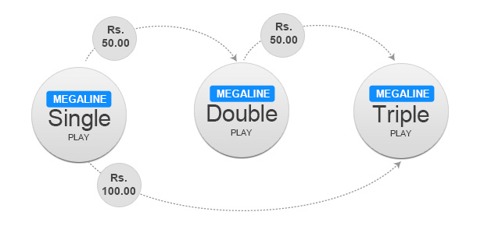
Usage Analysis
(VOICE)

Slide 3
VOICE calls usage analysis
Categories: ONNET, OFFNET, IDD (INCOMING & OUTGOING)
Separate analysis for each dataset.
User Identifier : event_source_hash
Steps:
Handle null values
Drop unnecessary columns
Pivot by month-year usage
Generating Usage rating by Call-count & Duration
Bin by User Locations
Outlier Analysis
Extract Usage and ratings (Categorical & Scaled)
Provide visualizations

Slide 4
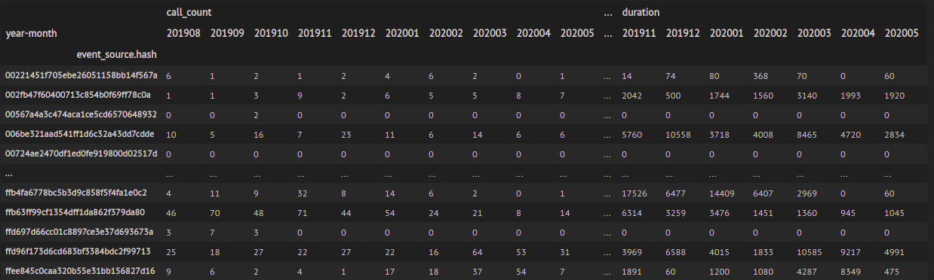
VOICE calls usage: Pivot table

Slide 5
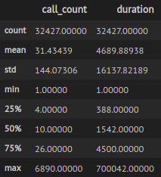
VOICE calls usage: Descriptive analysis
Call Count
0-26 within 75% (Q3) of the distribution
26-6890 within remaining 25% of the distribution
Call Duration
0-4500 seconds within 75% (Q3) of the distribution
4500-70042 seconds within remaining 25% of the distribution
VOICE ONNET INCOMING DATA

Slide 6
VOICE calls usage: Usage Ranking
Bins
0
1
2
3
.
.
7
8
Bined Call Counts - 8 Bins
Bin ranges selected considering skewness of data distribution (25,50,75th precentiles)
Ex: For ONNET INCOMING Data : [0, 6,15, 30, 100,1200,2400,4800,6890]
Bined Call Duration - 8 Bins
Bin ranges selected considering skewness of data distribution (25,50,75th precentiles)
Considered Business meaning of Durations ( As given in seconds, rounded to the nearest 60s)
Ex: For ONNET INCOMING Data : [0, 300, 1500, 4200,16800,33600,66000,240000,700042]
NO
LOW
Reference:
https://en.wikipedia.org/wiki/Freedman%E2%80%93Diaconis_rule#:~:text=For%20a%20set%20of%20empirical,of%20the%20theoretical%20probability%20distribution.
https://stats.stackexchange.com/questions/143438/optimal-number-of-bins-in-histogram-by-the-freedman-diaconis-rule-difference-be
HIGH

Slide 7
VOICE calls usage: Usage Ranking
Overall Usage ranking
Binned Call_Count x Binned Duration
Value between 0-64
ToDo: More advanced technique to combine variables?
Scaled values using Min-Max scalar (0-1)
Reference:
https://doi.org/10.1109/ICCE48956.2021.9352111, 2021 (Pham, C. D., Anh Chu, T., Pham, H. H., Linh Dao, M., Pham, T. S., Hung Trinh, V., & Nguyen, D. H. A recommendation system for offers in telecommunications)
http://www.utstat.toronto.edu/~brunner/DataAnalysisText/Interactions.pdf

Slide 8
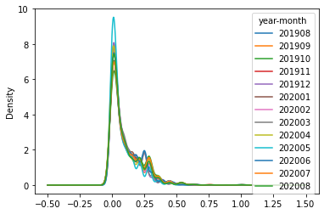
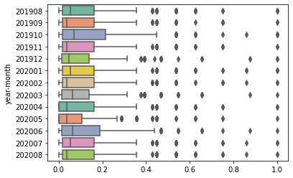
VOICE calls usage: Outlier analysis
VOICE ONNET INCOMING DATA : Density and Skewness
VOICE ONNET INCOMING DATA : Outliers

Slide 9
VOICE calls usage: Outlier analysis
Quantitative statistical methods to detect outliers
Tukey’s box plot method
Internally studentized residuals (AKA z-score method)
Median Absolute Deviation method
Tukey’s box plot method
Tukey distinguishes between possible and probable outliers. A possible outlier is located between the inner and the outer fence, whereas a probable outlier is located outside the outer fence.
IQR =Q3 - Q1, (whereas q3 := 75th quartile and q1 := 25th quartile)
Inner fence = [Q1 - 1.5 IQR , Q3 + 1.5 IQR]
Outer fence = [Q1 – 3 IQR , Q3 + 3 IQR]

Slide 10
VOICE calls usage: Outlier analysis
Outlier thresholds identified using Tukey’s box plot method:
{201908: {'threshold': 0.42857142857142855, 'count': 82}},
{201909: {'threshold': 0.42857142857142855, 'count': 66}},
{201910: {'threshold': 0.5357142857142857, 'count': 44}},
{201911: {'threshold': 0.42857142857142855, 'count': 66}},
{201912: {'threshold': 0.375, 'count': 83}},
{202001: {'threshold': 0.42857142857142855, 'count': 80}},
{202002: {'threshold': 0.42857142857142855, 'count': 69}},
{202003: {'threshold': 0.375, 'count': 73}},
{202004: {'threshold': 0.42857142857142855, 'count': 48}},
{202005: {'threshold': 0.26785714285714285, 'count': 252}},
{202006: {'threshold': 0.46875, 'count': 44}},
{202007: {'threshold': 0.42857142857142855, 'count': 84}},
{202008: {'threshold': 0.42857142857142855, 'count': 68}}

Slide 11
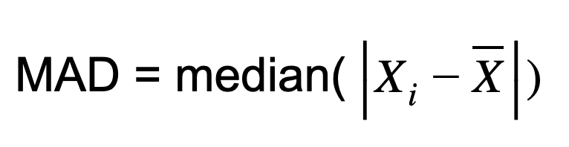
VOICE calls usage: Outlier analysis
Median Absolute Deviation method
This method is highly limited as the distributions mean and standard deviation are sensitive to outliers. This means that finding one outlier is dependent on other outliers as every observation directly affects the mean.

Slide 12
VOICE calls usage: Outlier analysis
Outlier thresholds identified using Median Absolute Deviation method:
{201908: {'threshold': 0.3571428571428571, 'count': 166}},
{201909: {'threshold': 0.3571428571428571, 'count': 129}},
{201910: {'threshold': 0.3571428571428571, 'count': 201}},
{201911: {'threshold': 0.3571428571428571, 'count': 133}},
{201912: {'threshold': 0.3125, 'count': 152}},
{202001: {'threshold': 0.3571428571428571, 'count': 167}},
{202002: {'threshold': 0.3571428571428571, 'count': 142}},
{202003: {'threshold': 0.3125, 'count': 162}},
{202004: {'threshold': 0.3571428571428571, 'count': 142}},
{202005: {'threshold': 0.3571428571428571, 'count': 83}},
{202006: {'threshold': 0.3125, 'count': 221}},
{202007: {'threshold': 0.3571428571428571, 'count': 177}},
{202008: {'threshold': 0.3571428571428571, 'count': 147}}

Slide 13
VOICE calls usage: Usage Ranking Categories
Bins
0
1
2
3
.
.
7
8
Usage Rankings Categorized into four categories
Categories: LOW/ MEDIUM/ HIGH/ NO
NO - No usage at all
Bin sizes defined using the same approach: considering data distribution (IQR)
Ex: Bins For ONNET INCOMING Data : [0, 0.08, 0.3,1]
NO
LOW
HIGH

Slide 14
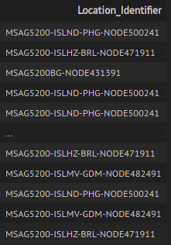
VOICE subscribers: Group by Location
Combined four columns together. To identify unique location of a subscriber
MSAN
Location_Code
EQUP_ID
EQUP_Index
Added new feature to User Profile : Location_Identifier
VOICE ONNET INCOMING DATA

Slide 15
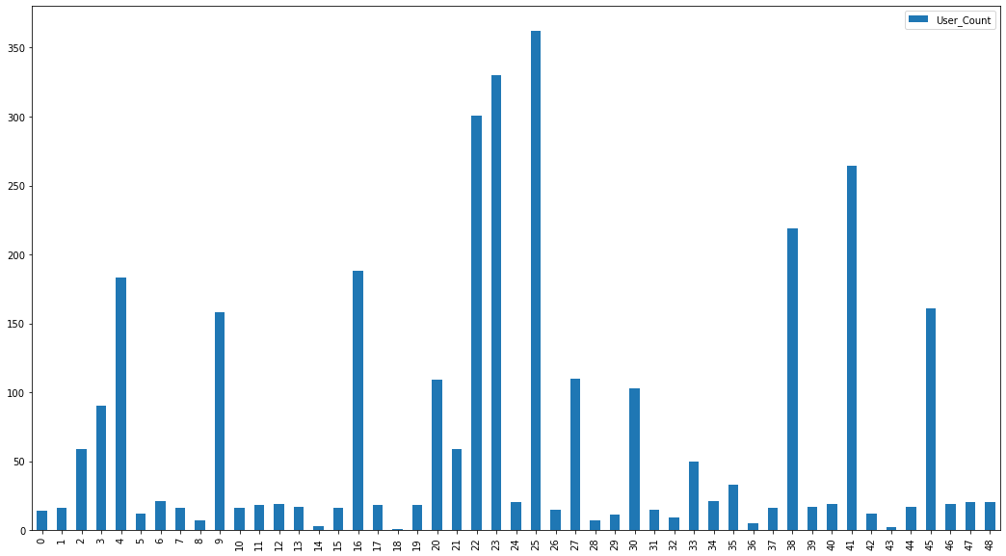
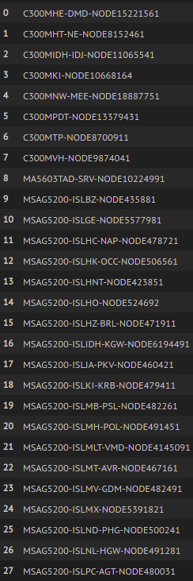
VOICE subscribers: Group by Location

Slide 16
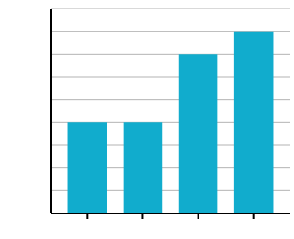
Usage Analysis
(BroadBand)

Slide 17
BroadBand usage analysis
User Identifier : PSTN_hash
Steps:
Handle null values
Drop unnecessary columns
Pivot by month-year usage
Generating Usage rating by Usage (Upload + download) & Duration
Bin by User Locations
Extract Usage and ratings (Categorical & Scaled)
Provide visualizations

Slide 18
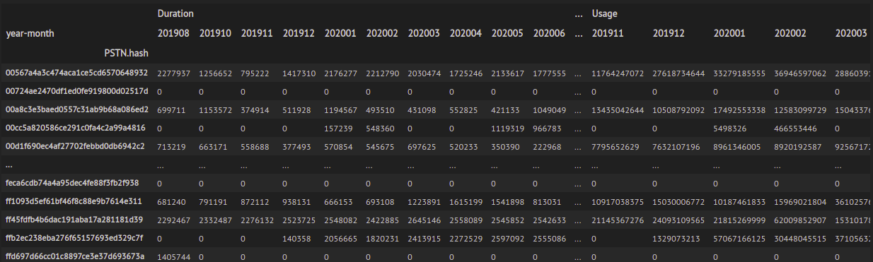
BroadBand usage: Pivot table

Slide 19
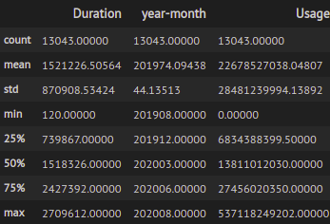
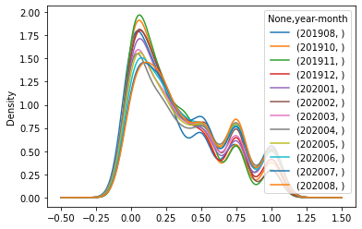
BroadBand usage: Descriptive analysis
Usage Columns
Usage (Upload + Download) - in bytes
Used Duration - in seconds
BB USAGE DATA

Slide 20
BroadBand usage: Usage Ranking
Bined Data Usage (Uploads+Downloads) - 4 Bins
Bin ranges selected considering skewness of data distribution (25,50,75th precentiles)
Bins: [0, 7057561283.25, 14188526279.5, 28226707481.75, 537118249202.0]
Bined Usage Duration - 4 Bins
Bin ranges selected considering skewness of data distribution (25,50,75th precentiles)
Considered Business meaning of Durations ( As given in seconds, rounded to the nearest 60s)
Bins : [0, 745381.25, 1522064.0, 2438034.0, 2709612.0]
Bins
0
1
2
.
.
4
NO
LOW
HIGH

Slide 21
BroadBand usage: Usage Ranking
Overall Usage ranking
Binned Usage x Binned Duration
Value between 0-16
ToDo: More advanced technique to combine variables?
Scaled values using Min-Max scalar (0-1)
Reference:
https://doi.org/10.1109/ICCE48956.2021.9352111, 2021 (Pham, C. D., Anh Chu, T., Pham, H. H., Linh Dao, M., Pham, T. S., Hung Trinh, V., & Nguyen, D. H. A recommendation system for offers in telecommunications)
http://www.utstat.toronto.edu/~brunner/DataAnalysisText/Interactions.pdf

Slide 22
BroadBand usage: Usage Ranking Categories
Usage Rankings Categorized into four categories
Categories: LOW/ MEDIUM/ HIGH/ NO
NO - No usage at all
Bin sizes (equal size strata)
Bins: [0, 0.33, 0.66, 1]
Bins
0
1
2
.
.
4
NO
LOW
HIGH

Slide 23
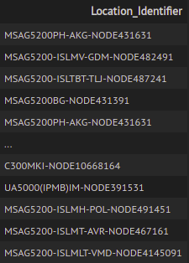
BroadBand subscribers: Group by Location
Combined four columns together. To identify unique location of a subscriber
MSAN
Location_Code
EQUP_ID
EQUP_Index
Added new feature to User Profile : Location_Identifier
BB DATA

Slide 24
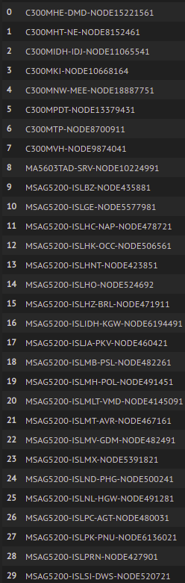
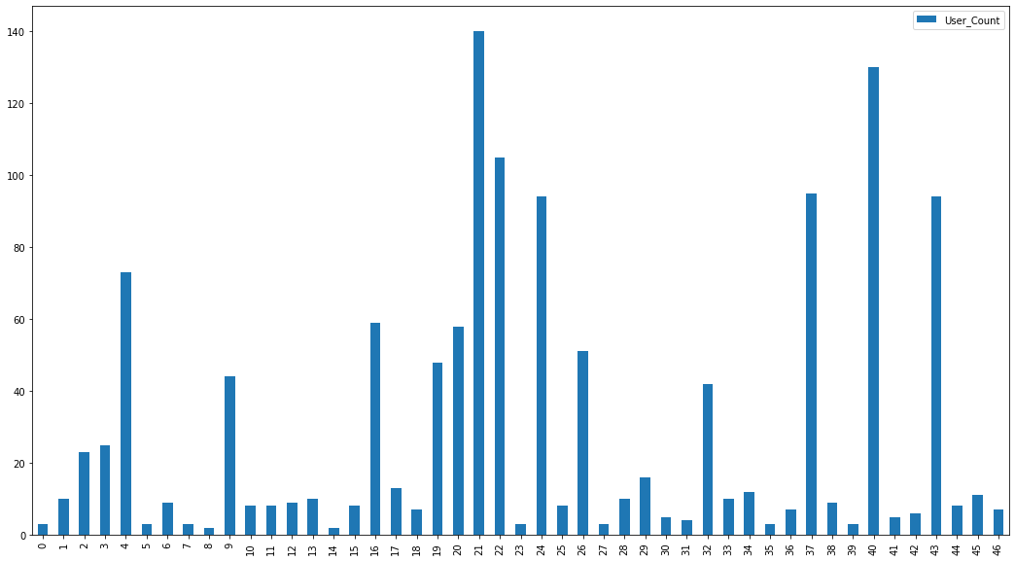
BroadBand subscribers: Group by Location

Slide 25
Usage Analysis
(PeoTV)

Slide 26
PeoTV usage analysis
User Identifier : Phone_Number_hash
Steps:
Handle null values
Drop unnecessary columns
Pivot by month-year usage
Transform Usage duration into measurable units (hours)
Generating Usage rating by Usage WatchTime (Duration)
Bin by User Locations
Identify PeoTV Packages and bin users by packages
Extract Usage and ratings (Categorical & Scaled)
Provide visualizations

Slide 27
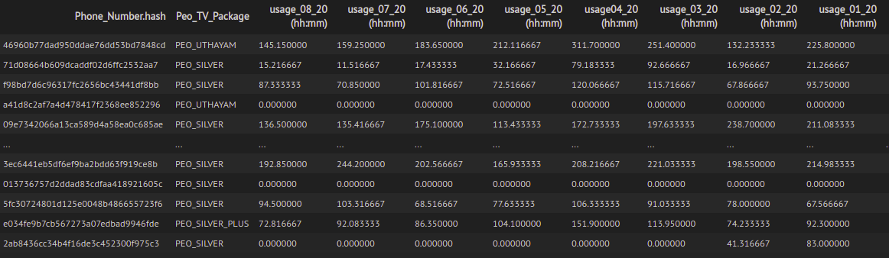
PeoTV usage: Transformed WatchTime

Slide 28
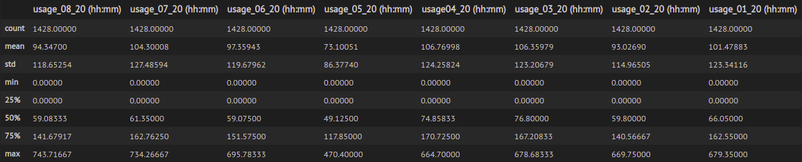
PeoTV usage: Descriptive analysis

Slide 29
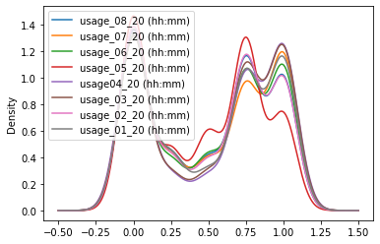
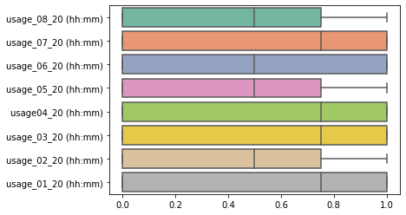
PeoTV usage: Descriptive analysis

Slide 30
PeoTV usage: Usage Ranking
Bined WatchTime (Hours) - 4 Bins
Bin ranges selected considering skewness of data distribution (25,50,75th precentiles)
Bins: [0, 30, 60, 150, 744]
Bins
0
1
2
.
.
4
NO
LOW
HIGH

Slide 31
PeoTV usage: Usage Ranking
Overall Usage ranking
Binned Usage x Binned Duration
Value between 0-16
ToDo: More advanced technique to combine variables?
Scaled values using Min-Max scalar (0-1)
Reference:
https://doi.org/10.1109/ICCE48956.2021.9352111, 2021 (Pham, C. D., Anh Chu, T., Pham, H. H., Linh Dao, M., Pham, T. S., Hung Trinh, V., & Nguyen, D. H. A recommendation system for offers in telecommunications)
http://www.utstat.toronto.edu/~brunner/DataAnalysisText/Interactions.pdf

Slide 32
PeoTV usage: Usage Ranking Categories
Usage Rankings Categorized into four categories
Categories: LOW/ MEDIUM/ HIGH/ NO
NO - No usage at all
Bin sizes (equal size strata)
Bins: [0, 0.33, 0.66, 1]
Bins
0
1
2
.
.
4
NO
LOW
HIGH

Slide 33
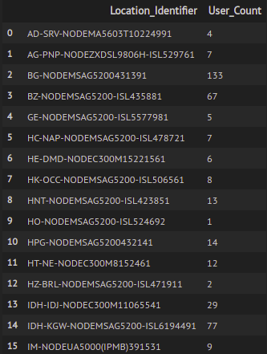
PeoTV subscribers: Group by Location
Combined four columns together. To identify unique location of a subscriber
MSAN
Location_Code
EQUP_ID
EQUP_Index
Added new feature to User Profile : Location_Identifier
PEOTV DATA

Slide 34
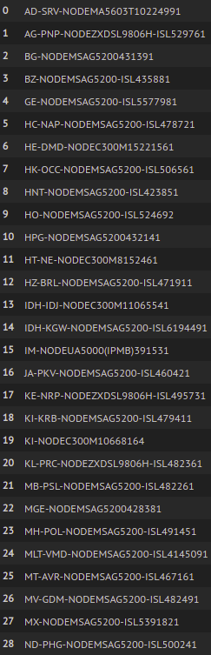
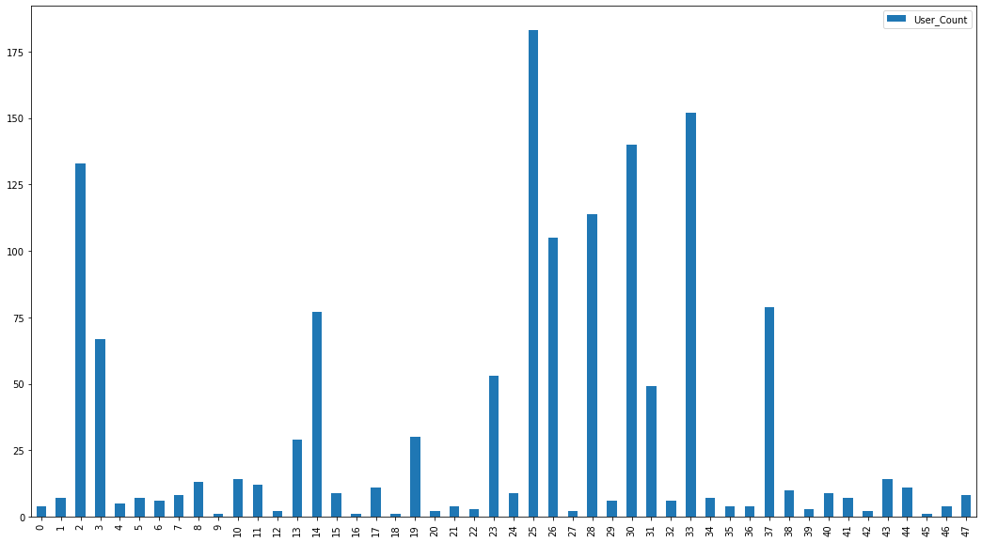
PeoTV subscribers: Group by Location

Slide 35
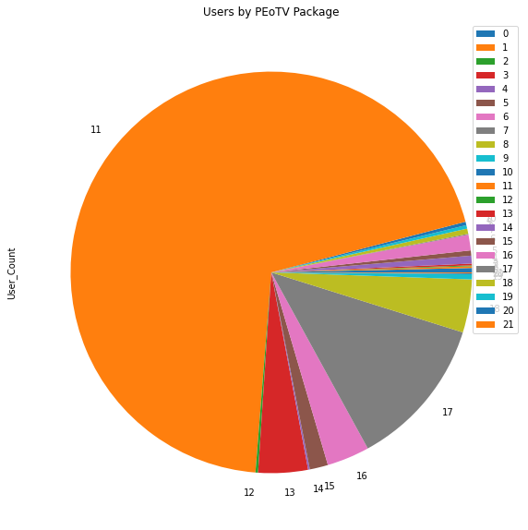
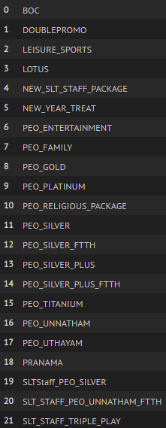
PeoTV subscribers: Group by PeoTV Packages

Slide 36
Product State Changes Analysis

Slide 37
Product State Changes analysis
User Identifier: Phone_Number.hash
Steps:
Identify Products List associated with users
Group phone numbers associated with each account
Group products purchased by each account/ phone number
Products count per each account/ phone number
Group users by products
Export generated data and maps for future use
Provide visualizations

Slide 38
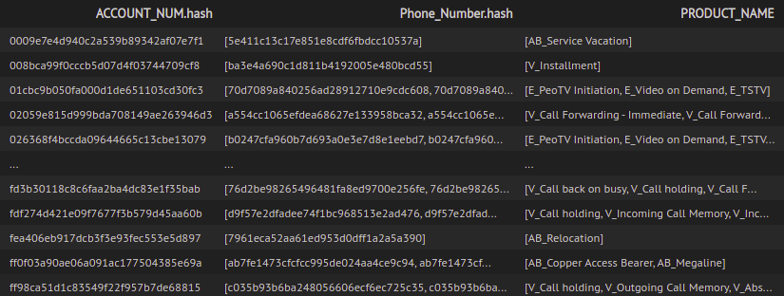
Phone numbers and Products associated

Slide 39
Maps: Products purchased by Phone numbers
Examples:
{'b635fc31617ffc9c1e6b5015fb32e108': 'V_Single VAS Bundle'},
{'ef74b1171331411a4d2e9fada9158215': 'E_Referral offer Discount'},
{'31110bf10f07e3d5e23da9680b1dd287': 'V_Absentee service'},
{'b6404a24d0ae0f5dbb11c78c783bd1fc': 'V_Hotline Service'},
{'b635fc31617ffc9c1e6b5015fb32e108': 'V_Caller Line Identification'},
{'b6404a24d0ae0f5dbb11c78c783bd1fc': 'V_Absentee service'},
{'b635fc31617ffc9c1e6b5015fb32e108': 'V_Call Forwarding Offline'},

Slide 40
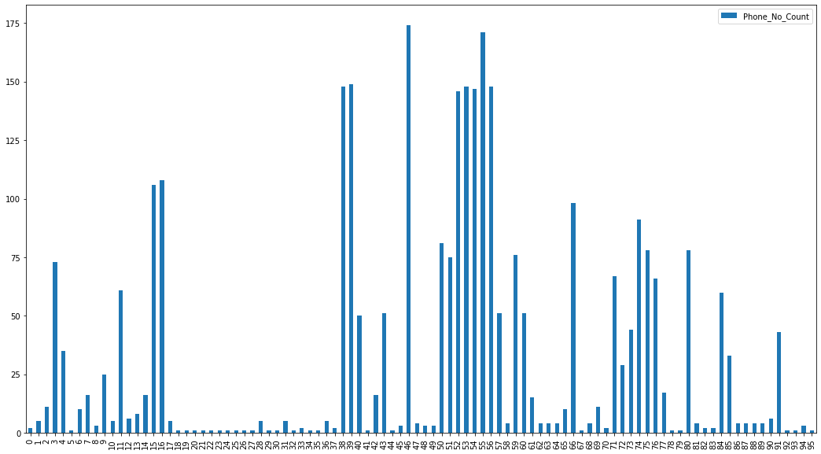
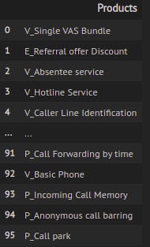
Users grouped by Products

Slide 41
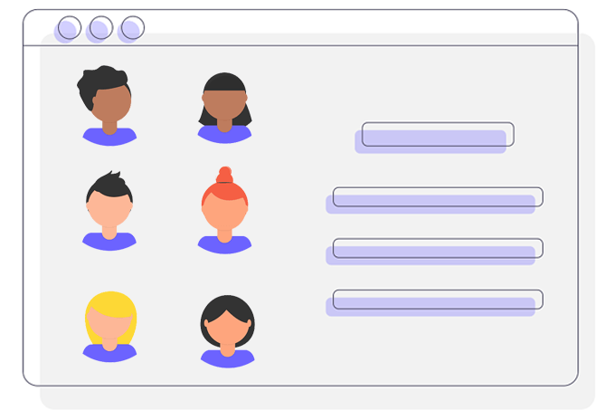
Extended User Profiles

Slide 42
User Profiles
User Profile Includes:
VOICE Usage Rankings (Scaled/ Categorical)
BroadBand Usage Rankings (Scaled/ Categorical)
PeoTV Usage Rankings (Scaled/ Categorical)
Identified PeoTV packages for each user
Identified VOICE packages for each user
Identified OTHER (not categorized) packages per each user
Unique Location Identifier
Subscription Type and Usage
Is Outlier? (YES/NO)
Derived socio-economic features
Household types (Kids/ Working Professional or Student/ Senior citizen/ Family member abroad)
Having Insurance? (Tele life/Tele health) (YES/NO)

Slide 43
User Profile cont’d.
VOICE Usage:
ONNET INCOMING Usage ranks
ONNET OUTGOING Usage ranks
OFFNET INCOMING Usage ranks
OFFNET OUTGOING Usage ranks
IDD INCOMING Usage ranks
IDD OUTGOING Usage ranks
Overall ONNET Usage ranks
Overall OFFNET Usage ranks
Overall IDD Usage ranks
Overall VOICE Usage ranks
Play Types:
SINGLE PLAY
DOUBLE PLAY
TRIPLE PLAY
Play Usage:
BB (HGH/LOW/MEDIUM/NO)
VOICE (HGH/LOW/MEDIUM/NO)
PEOTV (HGH/LOW/MEDIUM/NO)

Slide 44
User Profile: Usage ranking methods
VOICE Overall Usage binning method:
2 out 0f 3 Usage Rankings are HIGH, then HIGH
2 out 0f 3 Usage Rankings are LOW, then LOW
2 out 0f 3 Usage Rankings are MEDIUM, then MEDIUM
2 out 0f 3 Usage Rankings are NO, then LOW
If all Usage Rankings are NO, then NO
If 1 LOW, 1 HIGH, 1 MEDIUM Then MEDIUM

Slide 45
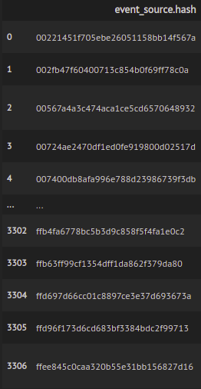
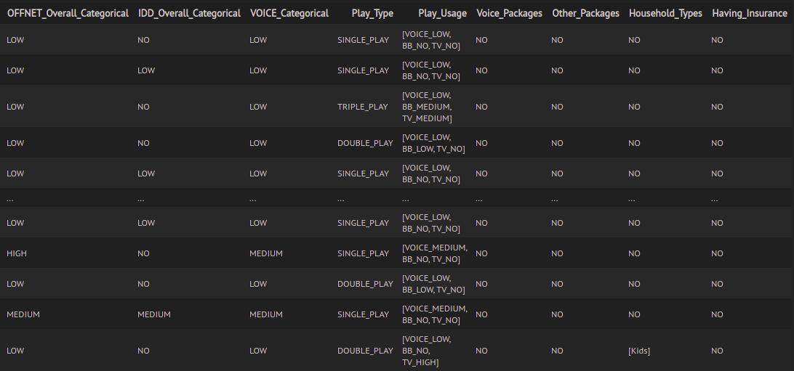
User Profile cont’d.

Slide 46
User Profile cont’d.
Customers with products from all categories (PeoTV, VOICE and Other)
40 / 3307 (1.2%)
Customers who has purchased Voice Packages and VAS
300 / 3307 (9.07%)
Customers who has purchased PeoTV Packages
1274 / 3307 (38.52%)
Customers who has purchased at least one Product or Package
1461 / 3307 (44.18%)

Slide 47
User Profile : Clustering Users
K-Means Clustering based on Scaled user features (Usage Ratings)
Best no of clusters (k) was selected using Elbow method
Three clusters were identified
Cluster 1: 914 users,
Cluster 2: 2145 users,
Cluster 3: 248 users
Hierarchical (Agglomerative) Clustering based on Scaled user features (Usage Ratings)
Best no of clusters were identified as 3.
Considered euclidean distances

Slide 48
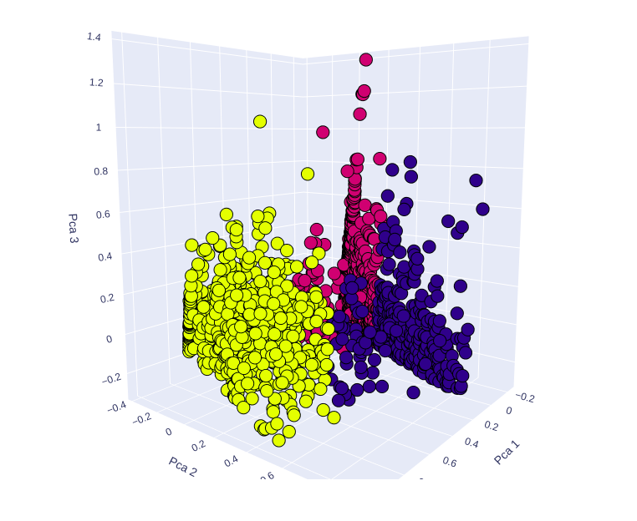
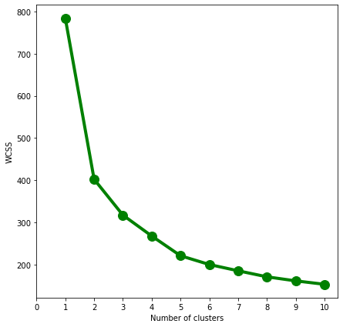
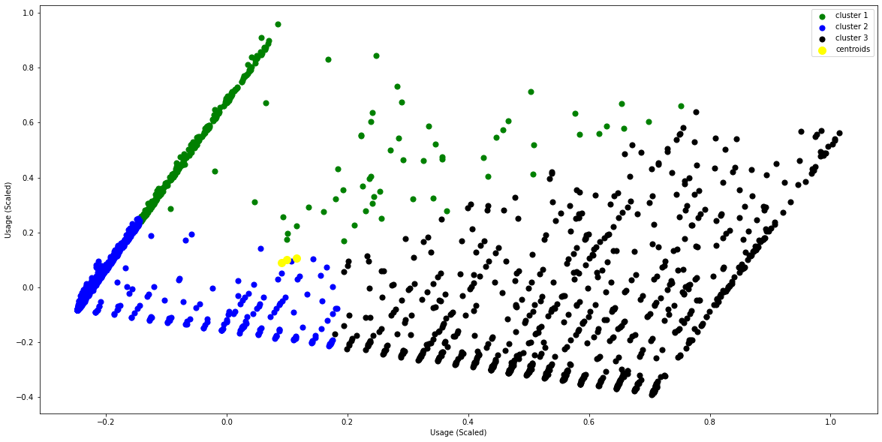
User Profile : Clustering Users
KMeans clustering - ELBOW
Three clusters identified

Slide 49
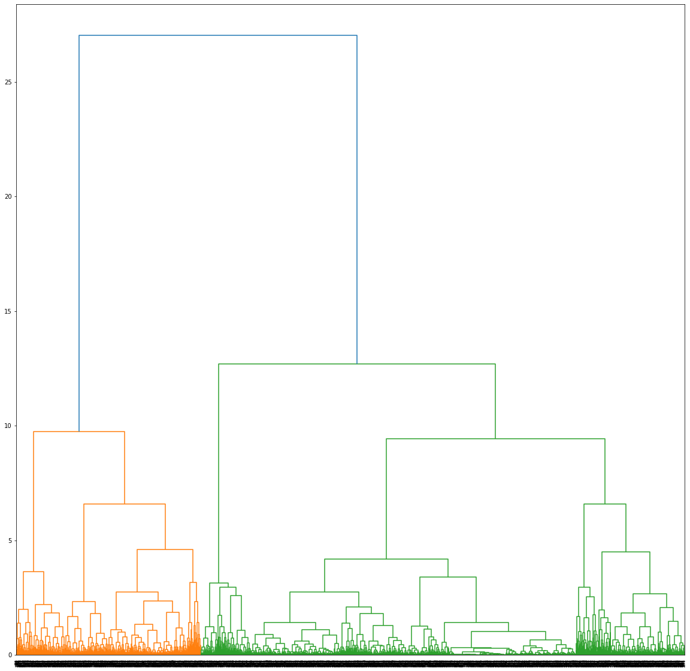
User Profile : Clustering Users
Clustering: Dendrogram

Slide 50

Extended Product Profiles

Slide 51
Product Profiles
Product Profile Includes:
Product/package details
Subscription Plans
Price (Downpayment)
Monthly Installments
Data plans (for BroadBand packages) (Time-based/Anytime/Unlimited)
Call Charges (VOICE packages)
TV Channels and monthly charges (PeoTV Packages)
Value Added services details (VAS)
Conditions
* Dependent Products
* Available locations
Data Extracted From:
SLT Web site, Annual report 2020

Slide 52
Product Profiles: Available features
Common features:
Product_ID - product code
Base_Type (BB/VOICE/PEOTV)
Pricing_Type (PAID/FREE)
Package_Type (ADSL/Fibre/4G/Telephone/PeoTV)
VAS (YES/NO) - value added service
Title and Description
Included_Packages - packages shipped with a product
Price (Rs.) - total cost, down payment or first installment
Monthly_Rental (Rs.)
Subscription_Type (SINGLE_PLAY/DOUBLE_PLAY/TRIPLE_PLAY)
Minimum_Subscription_Period (years)
Recidence_Type (Home/Office)
Tax_Status (INCLUDED/EXCLUDED)
Conditions - list of conditions for package
Available_Regions - list of available regions: MSAN or related level
Dependent_Packages (other products it depends on)

Slide 53
Product Profiles: Available features
BroadBand specific features:
BB_Data_standard (GB) - Standard data for a Time-based package
BB_Data_Free (GB) - Free data for a Time-based package
BB_Data_Anytime (GB) - data for anytime package
BB_Data_Unlimited (GB) - data for unlimited package
BB_Connection_Type (Time-based/Anytime/Unlimited)
BB_Connection_Speed (Download Speed/ Upload Speed)
VOICE specific features:
VOICE_Home_SLT_Instrument_Rental (Rs.) - Home Telephone rental (with SLT provided telephone)
VOICE_Home_Customer_Instrument_Rental (Rs.) - Home Telephone rental (with Customer provided telephone)
VOICE_Charge_Active_Hours (SLT-STL, SLT-Other) (Rs.) - Voice calls charges for Active hours
VOICE_Charge_Leisure_Hours (SLT-STL, SLT-Other) (Rs.) - Voice calls charges for Leisure hours
VOICE_Free_Minutes - Free voice call minutes given per package
VOICE_Telehelth_Insurance_Benefits (Rs.) - Awarded Benefit at fulfillment for SLT Telehealth Insurance packages
VOICE_Tele_Life_Insurance_Benefits (Rs.) - Awarded Benefit at fulfillment for SLT Tele Life Insurance packages
PeoTV specific features:
PEOTV_No_of_Channels - No of channels in a PEO TV package

Slide 54
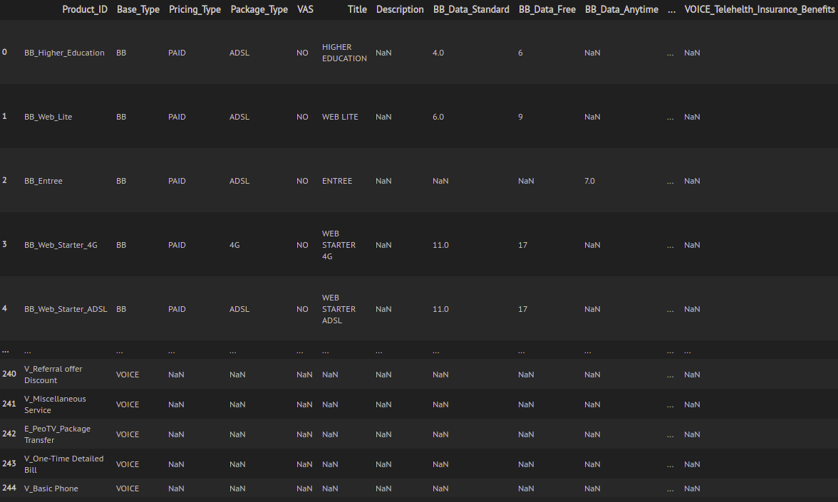
Product Profiles

Slide 55

Demonstration

Slide 56
Thank You

